Slide 1


Team Terrier
Ninglin Liu, Carnegie Mellon University
Ruoran Wang, Carnegie Mellon University
1
Digital Online Document: https://whimsical.com/reclothes-AoxfnBQ7rSc86PFvT4TFJy

Slide 2


Introductions
2

Slide 3
Agenda
Problem Statement
Business Solution
What is Reclothes
Quality Attributes
Tech Solution
Data Architecture
Tech Architecture
Tech Stack
Deployment Architecture
Security Architecture
Execution Plan
Cost Estimate
3

Slide 4

Business
Solution
Problem
Statement
4
4

Slide 5



Problem Statement
US produces over 17 million tons of textile waste every year.
> 50 %
Reference: Textile & Fashion Waste Statistics: Facts about clothing in landfills. Eco Friendly Habits. (2022, March 25). Retrieved May 8, 2022, from https://www.ecofriendlyhabits.com/textile-and-fashion-waste-statistics/
5

Slide 6

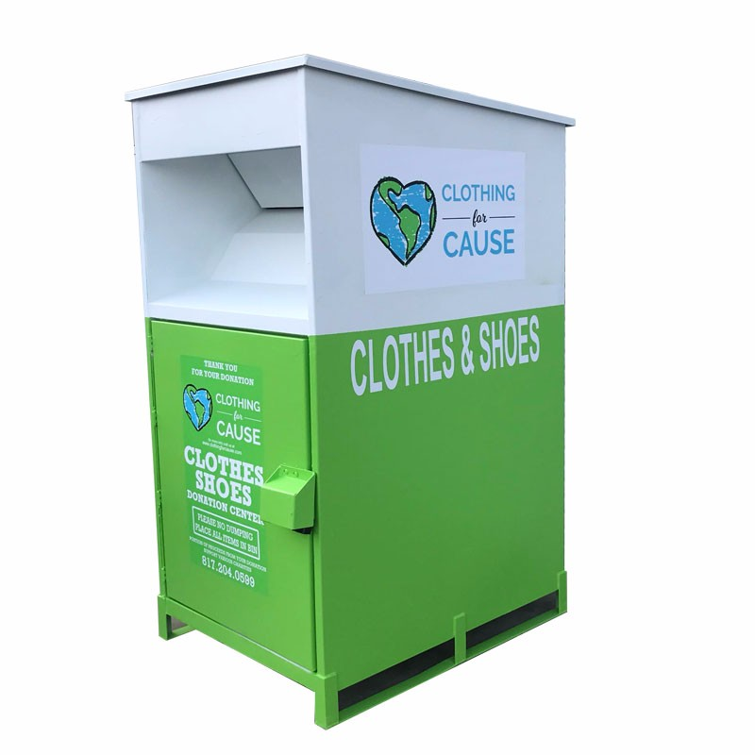

Problem Statement
Offline second hand Stores
Physical Cloth Donation Boxes
Online Recycling Platform
6

Slide 7
Problem Statement
Offline second hand Stores
Physical Cloth Donation Boxes
Online Recycling Platform
7

Slide 8


Problem Statement
Pain Point
Lack of Reward
Last Mile Solution
Offline second hand Stores
Physical Cloth Donation Boxes
Online Recycling Platform
8
Notes:
Analyze market size and put in this slide

Slide 9

Problem Statement
Pain Point
Lack of Reward
Last Mile Solution
Global Recycle Textile Market is projected to be USD 10.37 billion by 2028.
Offline second hand Stores
Physical Cloth Donation Boxes
Online Recycling Platform
Reference: Insights, T. B. (2022, March 21). Recycled textile market to reach USD 10.37 billion by 2028: Rising Technological Innovation and Clothing Recycling Initiative in the textile industry to drive growth, says the brainy insights. Recycled Textile Market to Reach USD 10.37 Billion by 2028 | Rising Technological Innovation and Clothing Recycling Initiative in the Textile Industry to Drive Growth, Says The Brainy Insights. Retrieved May 8, 2022, from https://www.prnewswire.com/news-releases/recycled-textile-market-to-reach-usd-10-37-billion-by-2028--rising-technological-innovation-and-clothing-recycling-initiative-in-the-textile-industry-to-drive-growth-says-the-brainy-insights-301506867.html
9
Notes:
As per the report published by The Brainy Insights, the global recycled textile market is projected to grow from USD 6.89 billion in 2020 to USD 10.37 billion by 2028, at a CAGR of 6.74% during the forecast period 2021-2028.

Slide 10

Business
Solution
10

Slide 11









What is ReClothes
Other Touchpoints:
Clothes drop-off Locations
Donor
Enterprise Users:
Delivery men, Reclothes employees
Mobile app for donation
Online Marketplace
Consumer
Enterprise Software:
Mobile app for Delivery men,
ERP System for Reclothes employees
Scrap Factories
11

Slide 12
What is ReClothes
Donation Working Process
Other Touchpoints:
Clothes drop-off Locations
Donor
Enterprise Users:
Delivery men, Reclothes employees
Mobile app for donation
Online Marketplace
Consumer
Enterprise Software:
Mobile app for Delivery men,
ERP System for Reclothes employees
Scrap Factories
12

Slide 13
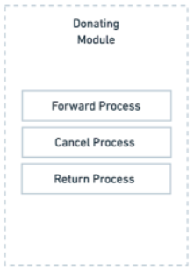
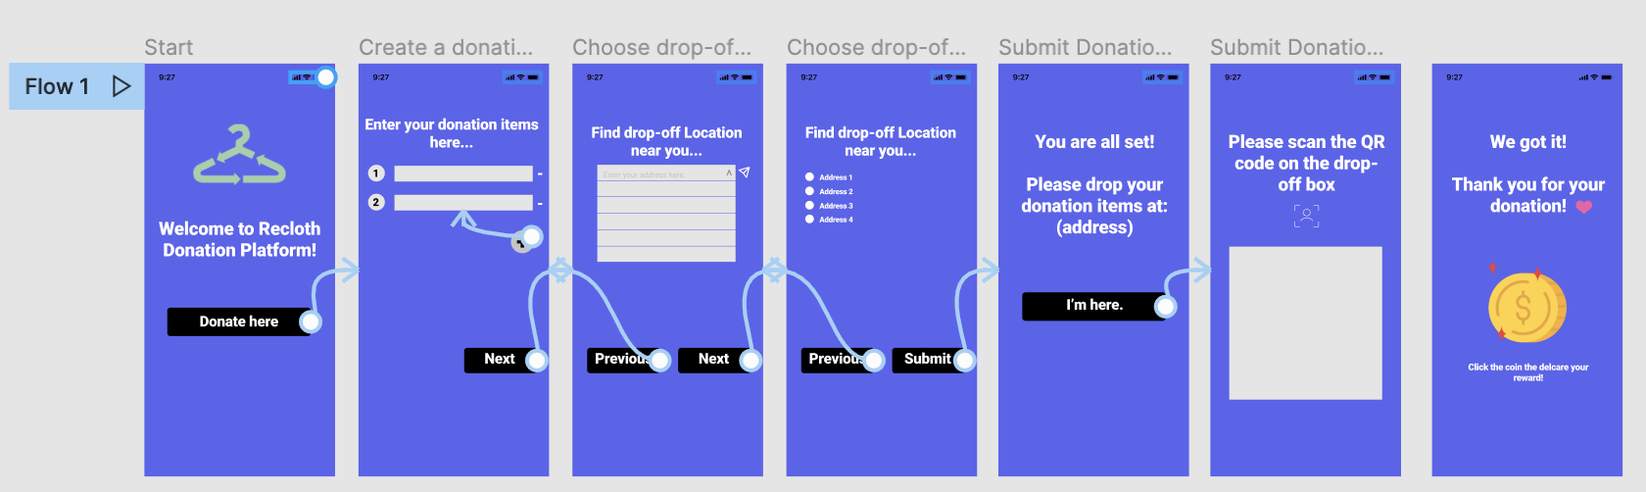
Donation Working Process
Donor’s User interface
13

Slide 14
What is ReClothes
Marketplace Working Process
Clothes drop-off Locations
Donor
Enterprise Users:
Delivery men, Reclothes employees
Mobile app for donation
Online Marketplace
Consumer
Enterprise Software:
Mobile app for Delivery men,
ERP System for Reclothes employees
Scrap Factories
14

Slide 15
What is ReClothes
Enterprise Working Process
Clothes drop-off Locations
Donor
Enterprise Users:
Delivery men, Reclothes employees
Mobile app for donation
Online Marketplace
Consumer
Enterprise Software:
Mobile App for Delivery men,
ERP System for Reclothes employees
Scrap Factories
15

Slide 16
What is ReClothes
Clothes drop-off Locations
Donor
Enterprise Users:
Delivery men, Reclothes employees
Mobile app for donation
Online Marketplace
Consumer
Enterprise Software:
Mobile app for Delivery men,
ERP System for Reclothes employees
Scrap Factories
16

Slide 17


Quality Attributes
Scalability
Security
Handle inconsistent website traffic
Secure account and transaction
17
Notes:
Scalability & Flexibility - use microservice:
The system is able to support large visiting volume from customers.
2 working processes may demand different resources. Flexible in terms of changing resources allocated according to the demand of working processes, which run in parallel
Security:
Use AWS security infrastructure to protect user’s account and transactions
我们的平台开始人不多，但是逐渐到后期，人流量会增长很快，这就需要我们的平台有scalability的能力
由于我们的平台设计很多用的隐私信息，同时还有payment，所以security很重要

Slide 18
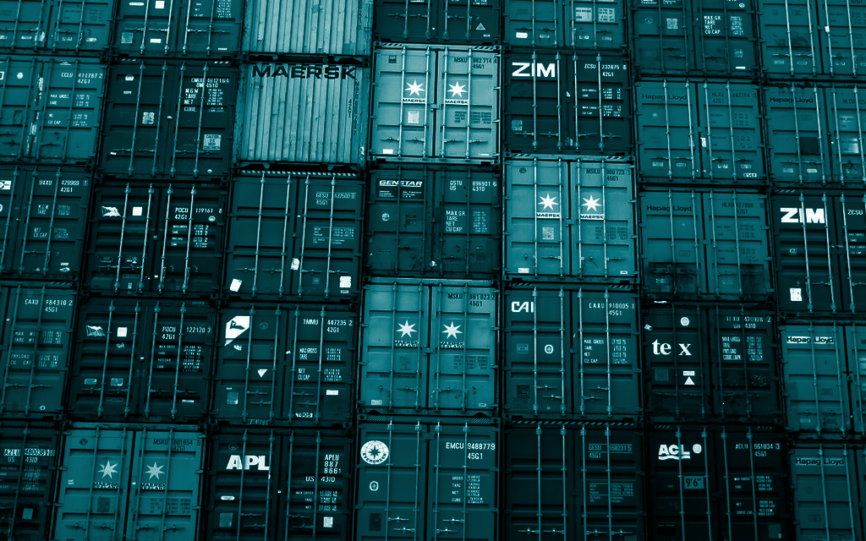
Tech
Solution
18

Slide 19
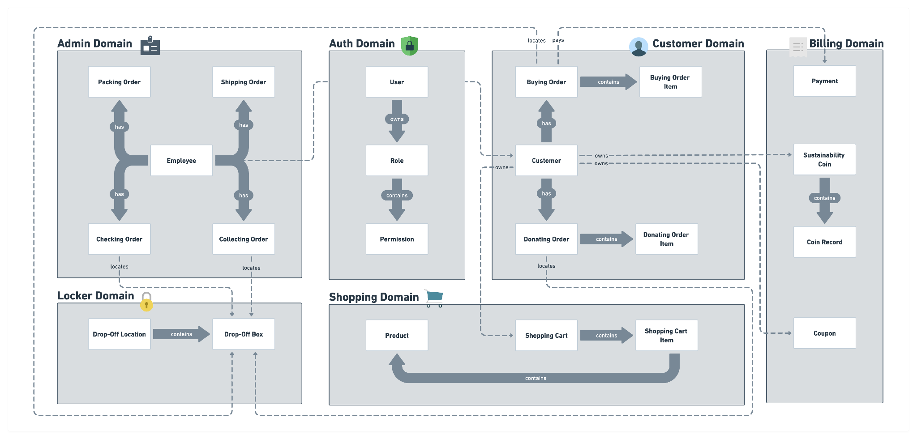
Data Architecture
By using domain-driven design design, we separate the whole system into separate domains. Each domain is a bounded context and we put data models that have frequent interaction into the same domain. The diagram below shows 6 domains in our system.
Auth Domain, Admin Domain, Customer Domain, Shopping Domain, Billing Domain, Locker Domain
19
Notes:
For Data Architecture, we used the Data-Driven Design method and separate the whole platform into 6 domains. Each of them is a bounded context and is responsible for resolving a set of problems. We got the admin domain that focuses on activities related to the internal users. And customer domain that focuses on activities related to the external users. Auth domain is responsible for authentication and authorization. The locker domain focuses on the drop-off box and the drop-off location. The shopping domain focuses on browsing used clothes and the management of shopping carts.

Slide 20
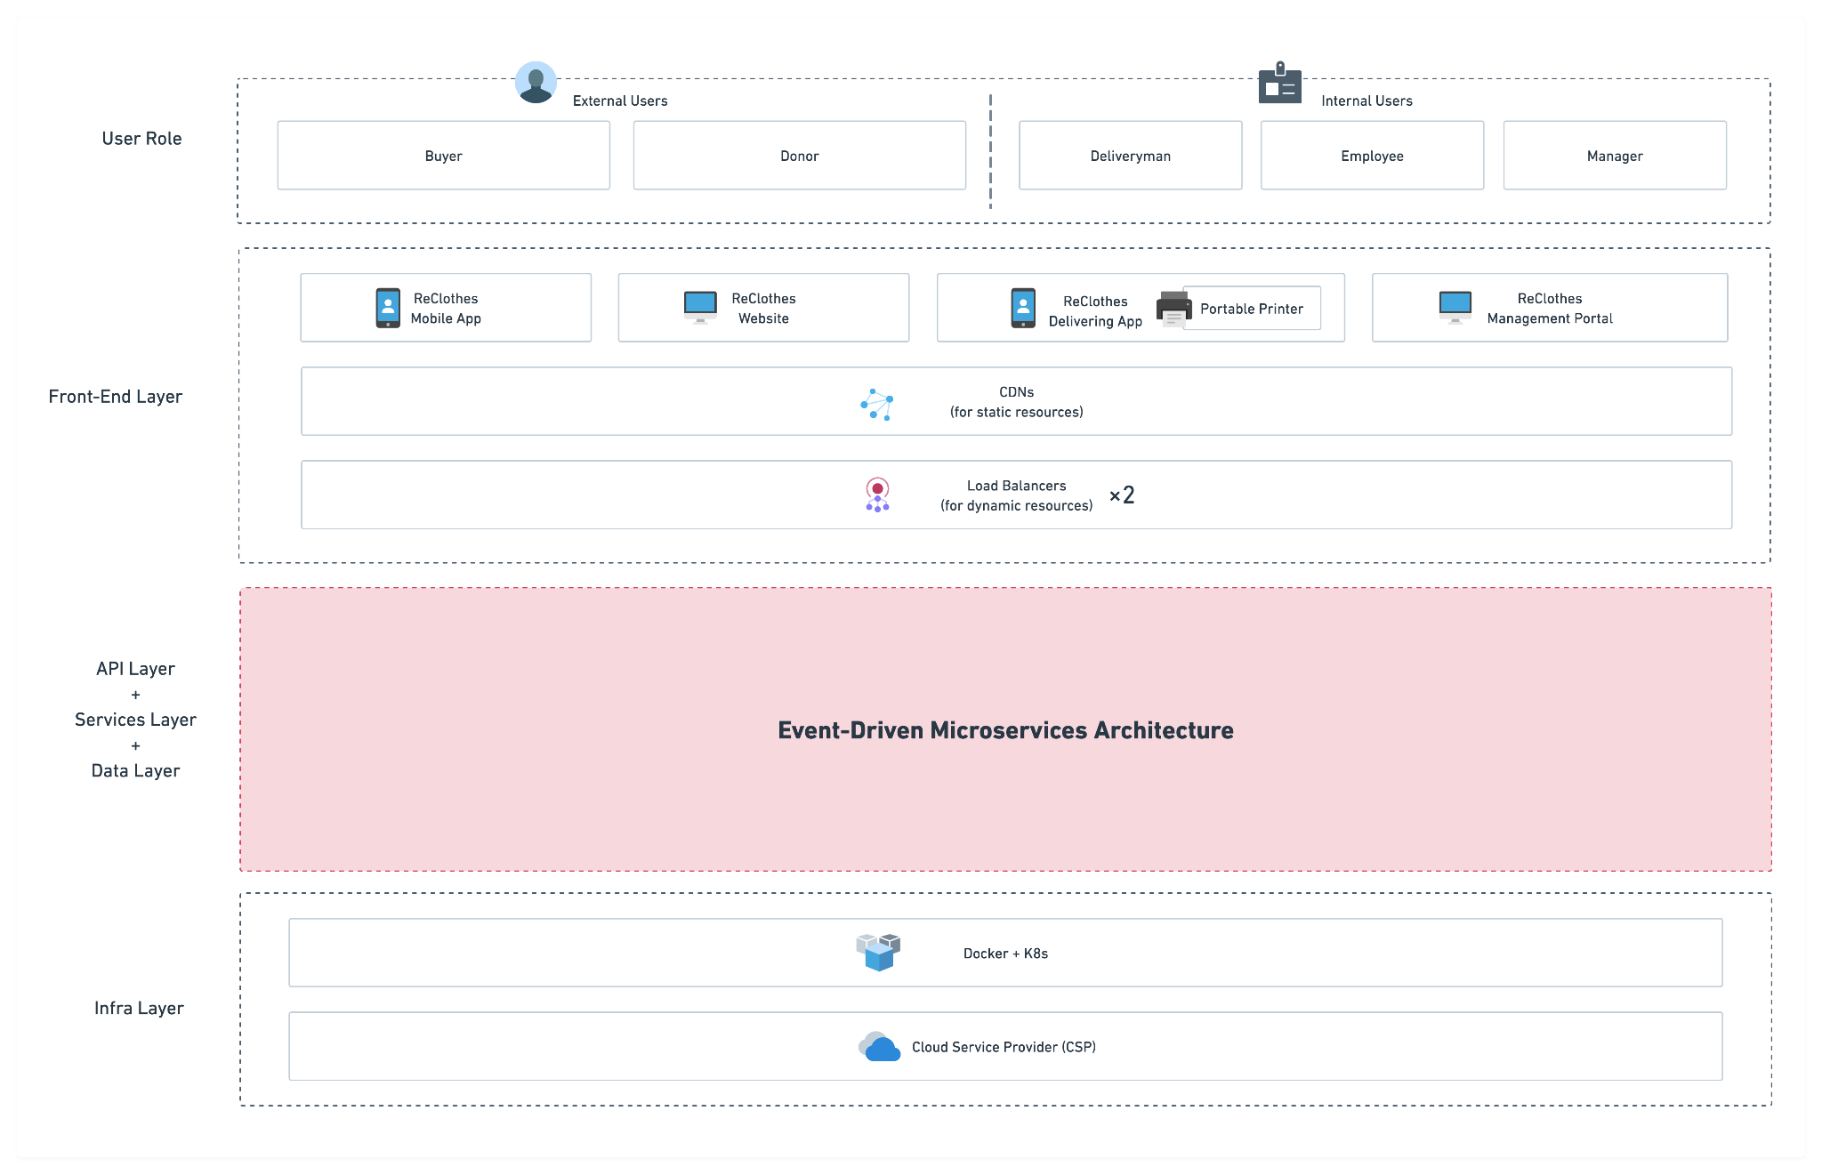
Tech Architecture
20
Notes:
This is our tech architecture, and we used event-driven microservices architecture to achieve the scalability of the platform. In this diagram, we split the platform into several layers. We got the front-end layer, API layer, services layer, data layer, and infrastructure layer. In the front-end layer, we got loader balancers to distribute traffic loads equally. And we also used CDN to improve the speed of retrieving static resources. In the infrastructure layer, we build a Kubernetes cluster on top of the cloud provider.

Slide 21
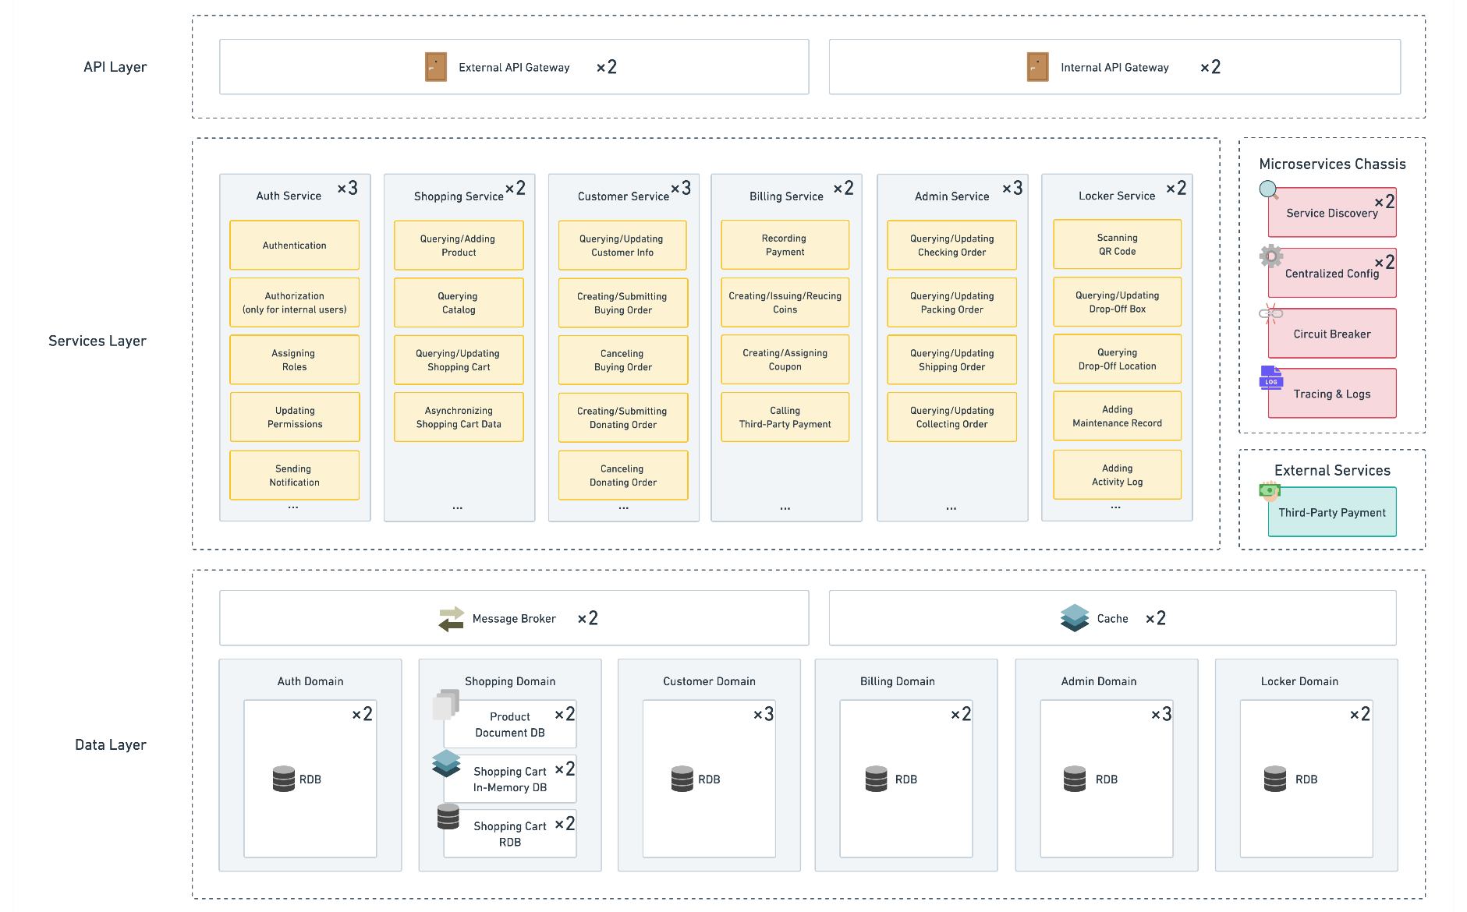
Tech Architecture
21
Notes:
This diagram shows detailed components in the middle of three layers. In the API layer, we used the external API gateway and the internal API gateway to distribute traffic loads coming from different users. By using these two API gateways, we can set different access control and throttling strategy for them. Next, in the service layer, we got six microservices to serve requests. For developing these microservices, we got a microservices chassis that contains service discovery, centralized config service, circuit breaker, tracing, and logging. For the payment, the billing service needs to connect with some third-party services, such as Stripe or PayPal. Next is our data layer, each service needs to connect with its independent databases. For example, the shopping service uses the document DB to store the used clothes. Using the in-memory database to store the shopping cart data. Using the relational database for the persistence of the shopping cart data.

Slide 22
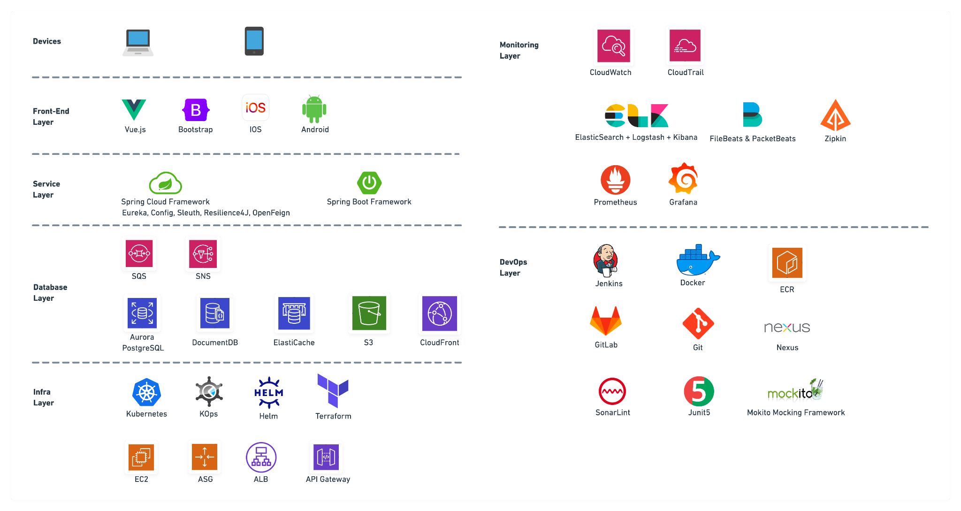
Tech Stack
22
Notes:
In the diagram of Tech Stack, we chose a bunch of frameworks or tools to establish our tech architecture. In the front-end layer, we used Vue.js and Bootstrap for the front-end of the management portal and used IOS and Android to build mobile apps. In the service layer, we used Spring Cloud Framework and Spring Boot Framework to build a microservice architecture. In the database layer, we used several different AWS services for different databases. We got SQS for message queues, SNS for notification, Aurora for relational databases, DocumentDB for document databases, Elasticache for the in-memory database, S3 for the static resources, and CloudFront for the CDN. In the infrastructure layer, we used Kops, Helm, and Terraform to build a Kubernetes cluster. And under this cluster, it used EC2 instance, ASG, ALB, and API Gateway. In the monitoring layer, we used AWS CloudWatch and AWS CloudTrail for logging and monitoring. The ELK stack, Filebeasts, and PacketBeats for monitoring business logs generated in all Kubernetes pods. Using Zipkin UI to present a dependency diagram from a request went through each service. Using Prometheus and Grafana for monitoring the Kubernetes cluster. In the DevOps layer, we used Jenkins, Docker, ECR, Gitlab, Nexus, and Sonarlint to build a CI/CD pipeline. Using Junit5 and Mokito for testing.

Slide 23
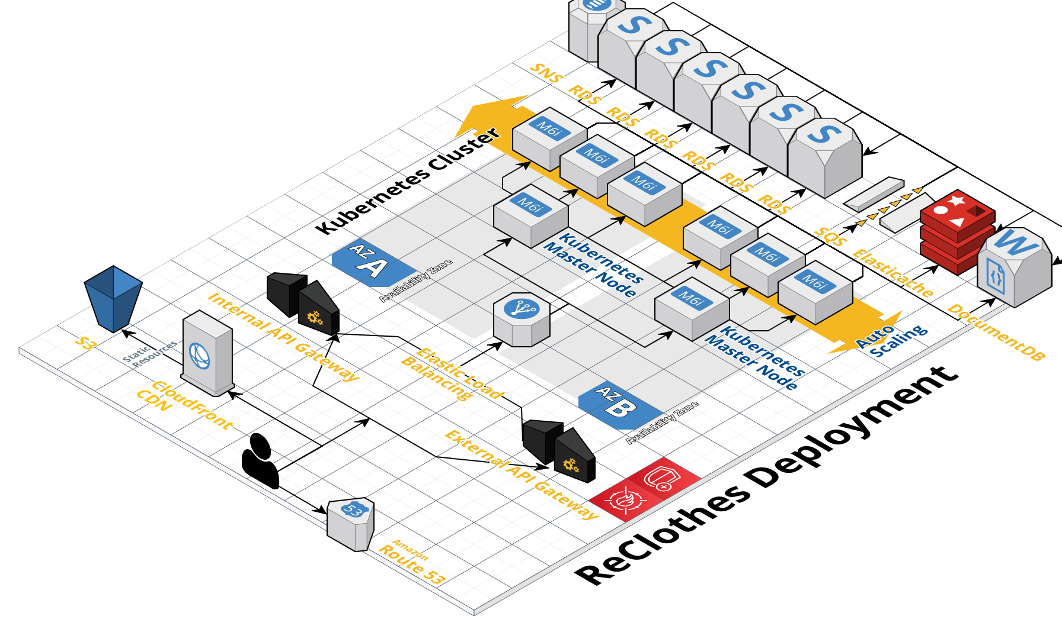
Deployment Architecture
Cloud Provider: AWS
Container Orchestration: Kubernetes
K8S Cluster Management: KOps, Helm
Generated by CloudCraft: https://www.cloudcraft.co/
23
Notes:
This diagram shows how we deploy our solution into AWS. This is the front-end layer, this is the API layer, this is the service layer, and the last one is the database layer. For deploying microservices in the service layer, we used two master nodes and six slave nodes to build a Kubernetes cluster. Every time Jenkins uses CI/CD pipeline to generate a pod from the Docker image and deploy it into the Kubernetes cluster. In addition, this cluster has the ability of auto-scaling that is based on the CPU utilization.

Slide 24
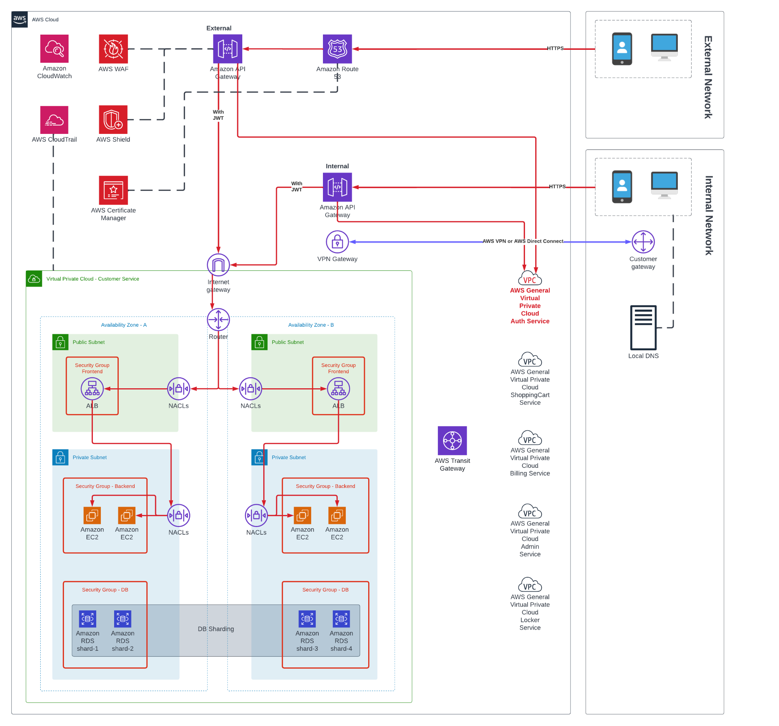


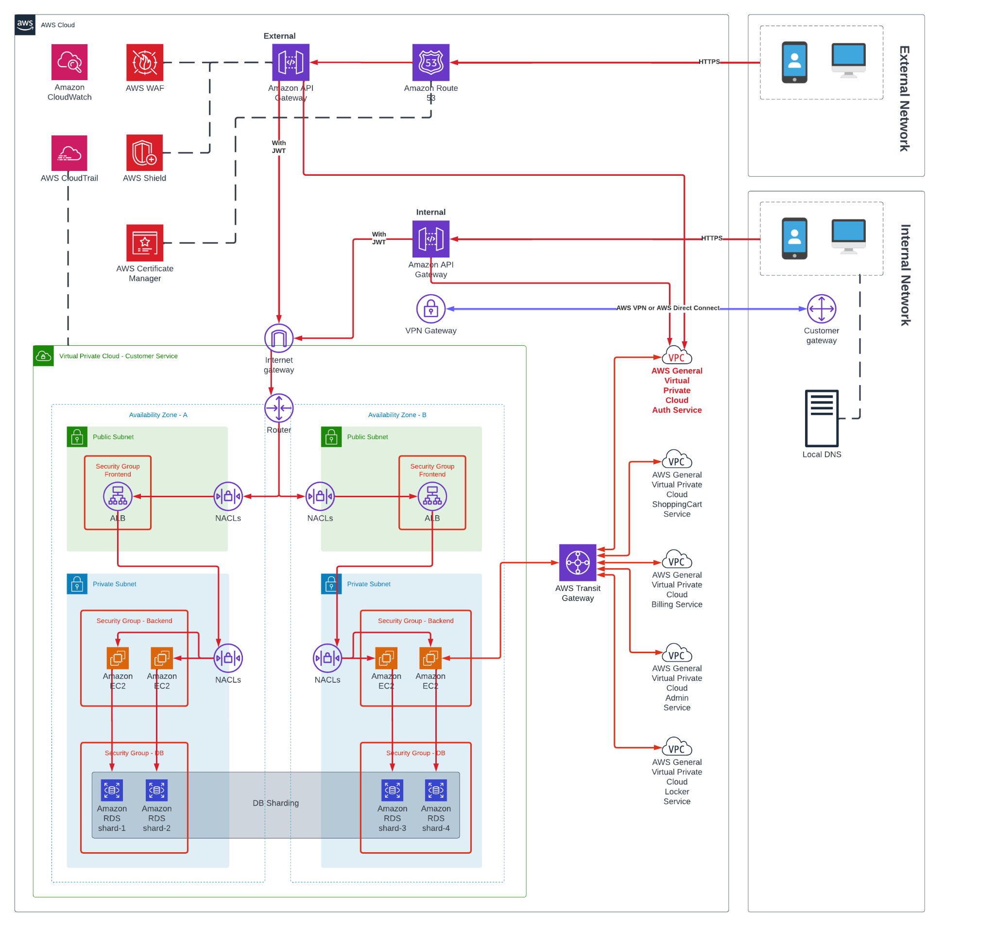
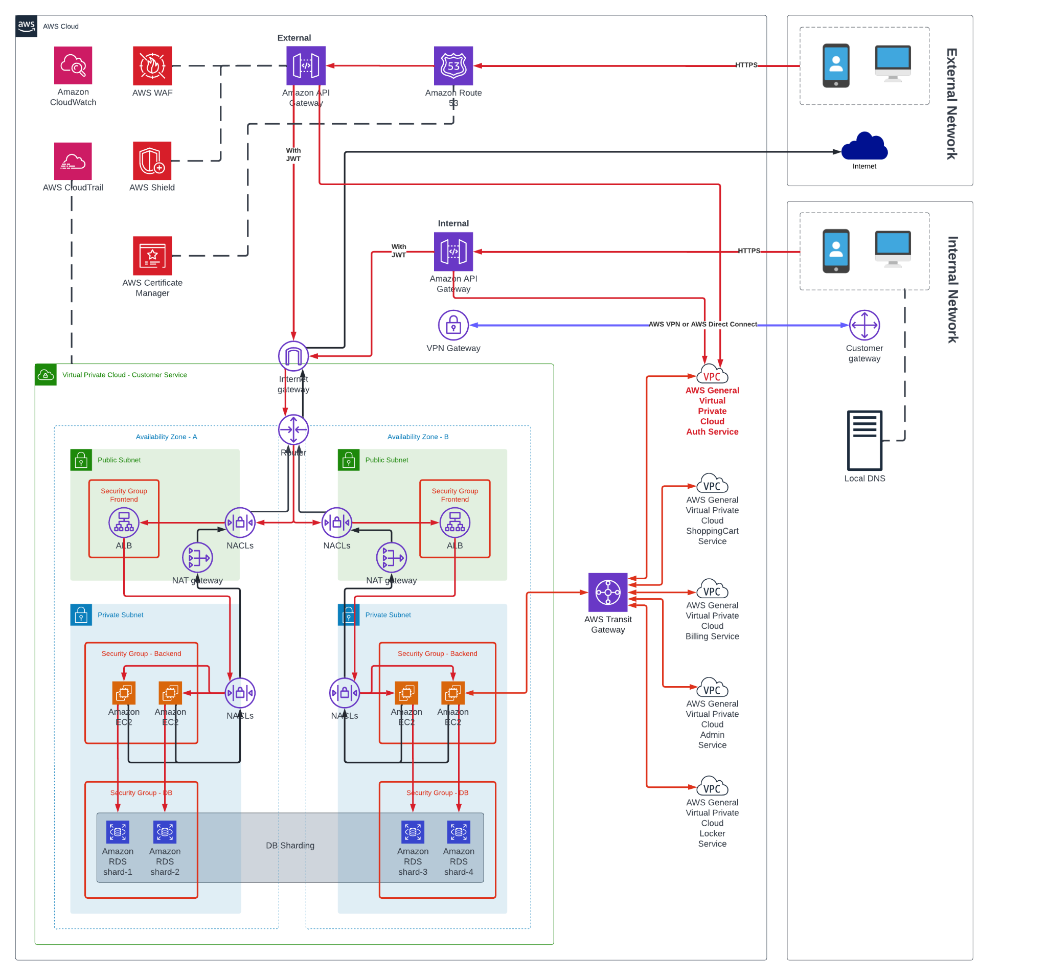
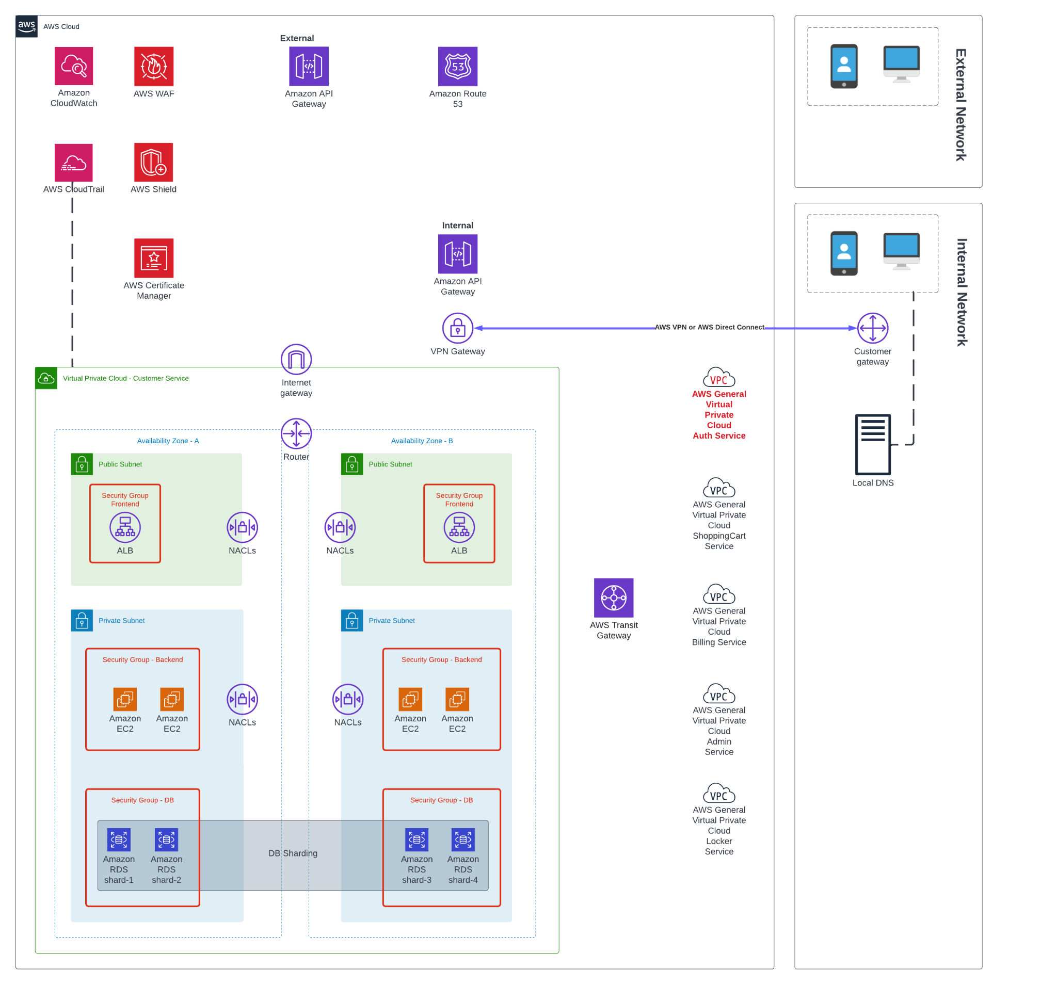
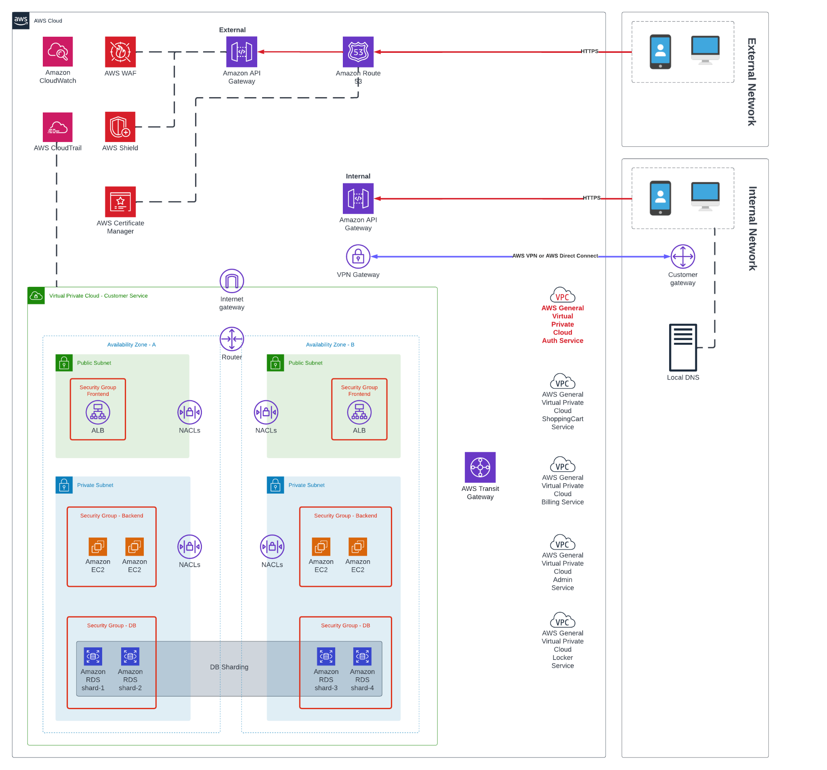
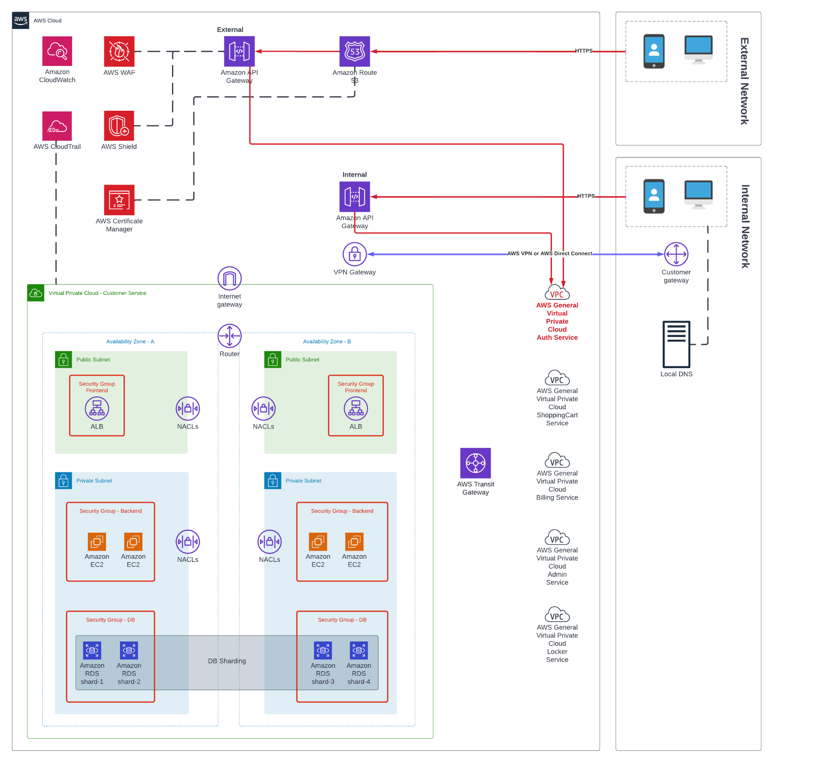


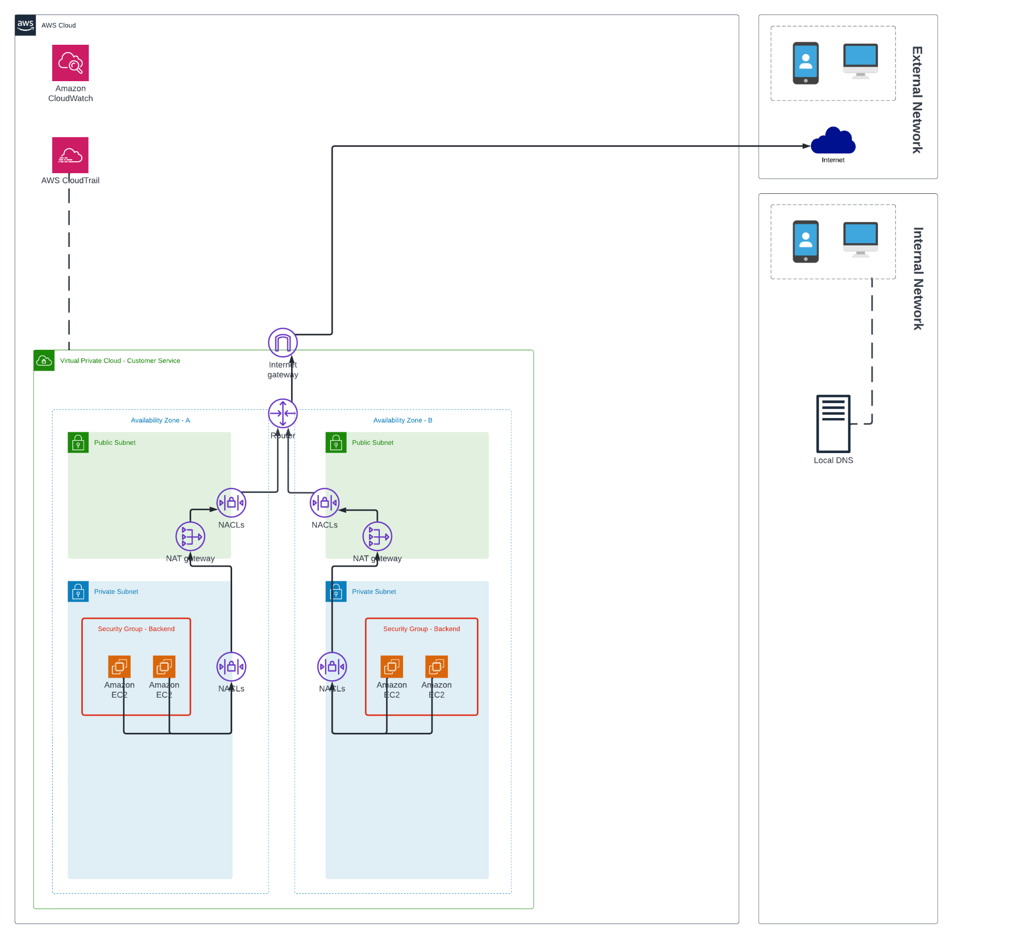
Security
Architecture
We have several approaches to keep the platform is under secure.
VPN for internal users
AWS Shield
AWS WAF
VPC isolation
Public and private subnets
NACLs and SGs
Auth Domain for authentication and authorization
AWS Cloudwatch and AWS CloudTrail
traffic coming in
traffic going out
Generated by Lucidchart: https://www.lucidchart.com/
24
Notes:
To achieve the security that we selected attributes, we used almost all AWS native services or tools to keep security. First, We used a VPN Gateway and a Customer Gateway to create a secure connection between the AWS Cloud and the internal network. Second, the platform only receives HTTPS requests, after requests arrive the API gateway, the AWS Shield can prevent DDOS attacks and AWS WAF can do IP filterings. Thirdly, we created each service in one VPC for isolating them from each other. For the communication between services, we transfer requests to AWS Transit Gateway. Fourthly, we put critical stuff such as Kubernetes cluster and databases into private subnets and put application load balancers into public subnets. Fifthly, we used NACLS and SGs as virtual firewalls to secure traffic. Sixthly, auth service in the service layer can help us do the authentication and authorization for all requests. After authentication, auth service will generate a JWT and attach it to the request for other services to get user information. Lastly, AWS CloudWatch and CloudTrail are great for logging and monitoring. For traffic going out of the platform, we used NAT gateways to build a bridge to connect components outside of the VPC.

Slide 25
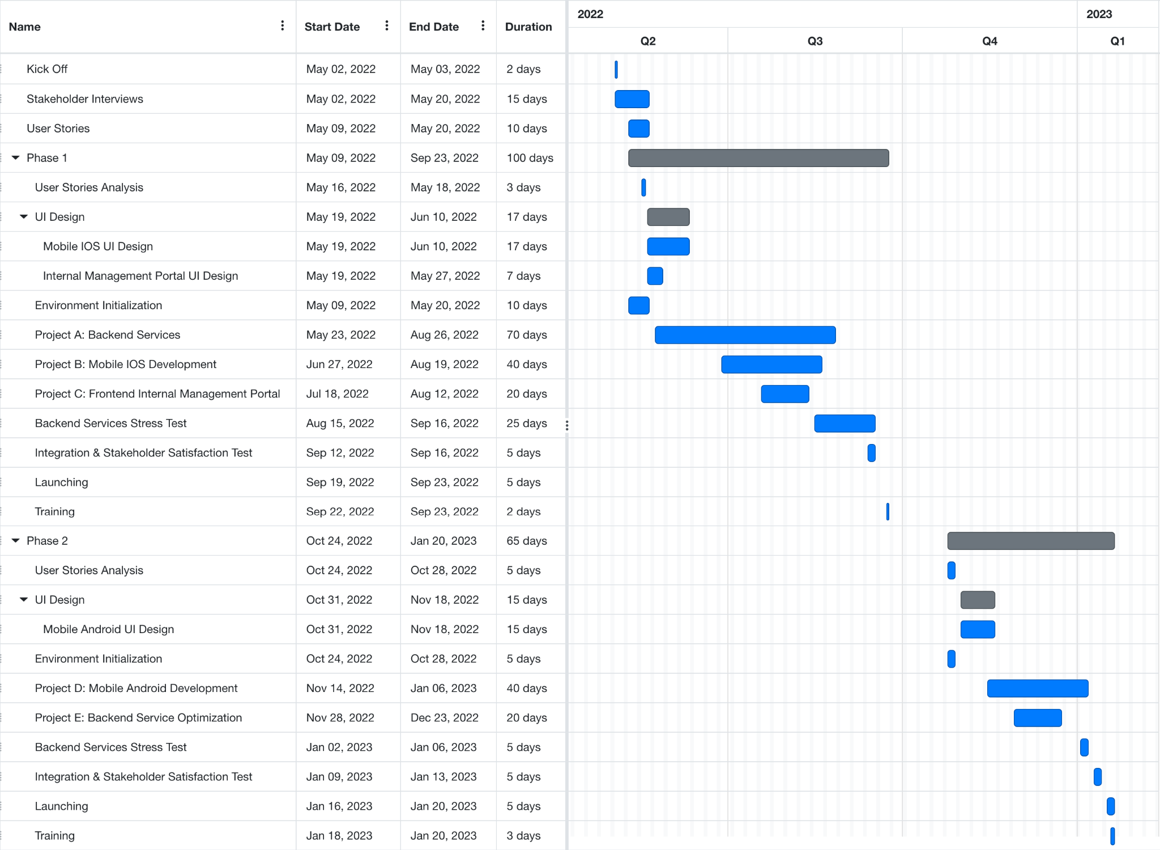
Execution Plan
Back-End Service Dev
Agile Team 1 (6*dev + 2*test)
Auth Service
Admin Service
Customer Service
Agile Team 2 (6*dev + 2*test)
Shopping Service
Billing Service
Locker Service
Phase 1 (getting to market quickly)
About 7 month
Core functions in 6 services
IOS development
Phase 2 (optimization)
About 4 month
Advanced functions in 6 services
Android development
Generated by Free Online Gantt Chart Software: https://www.onlinegantt.com/
25
Notes:
This is our execution plan that is split into two phases. Phase 1 focuses on the development of 6 services and the IOS app. Phase 2 focuses on the development of optimization of 6 services and the android app.

Slide 26
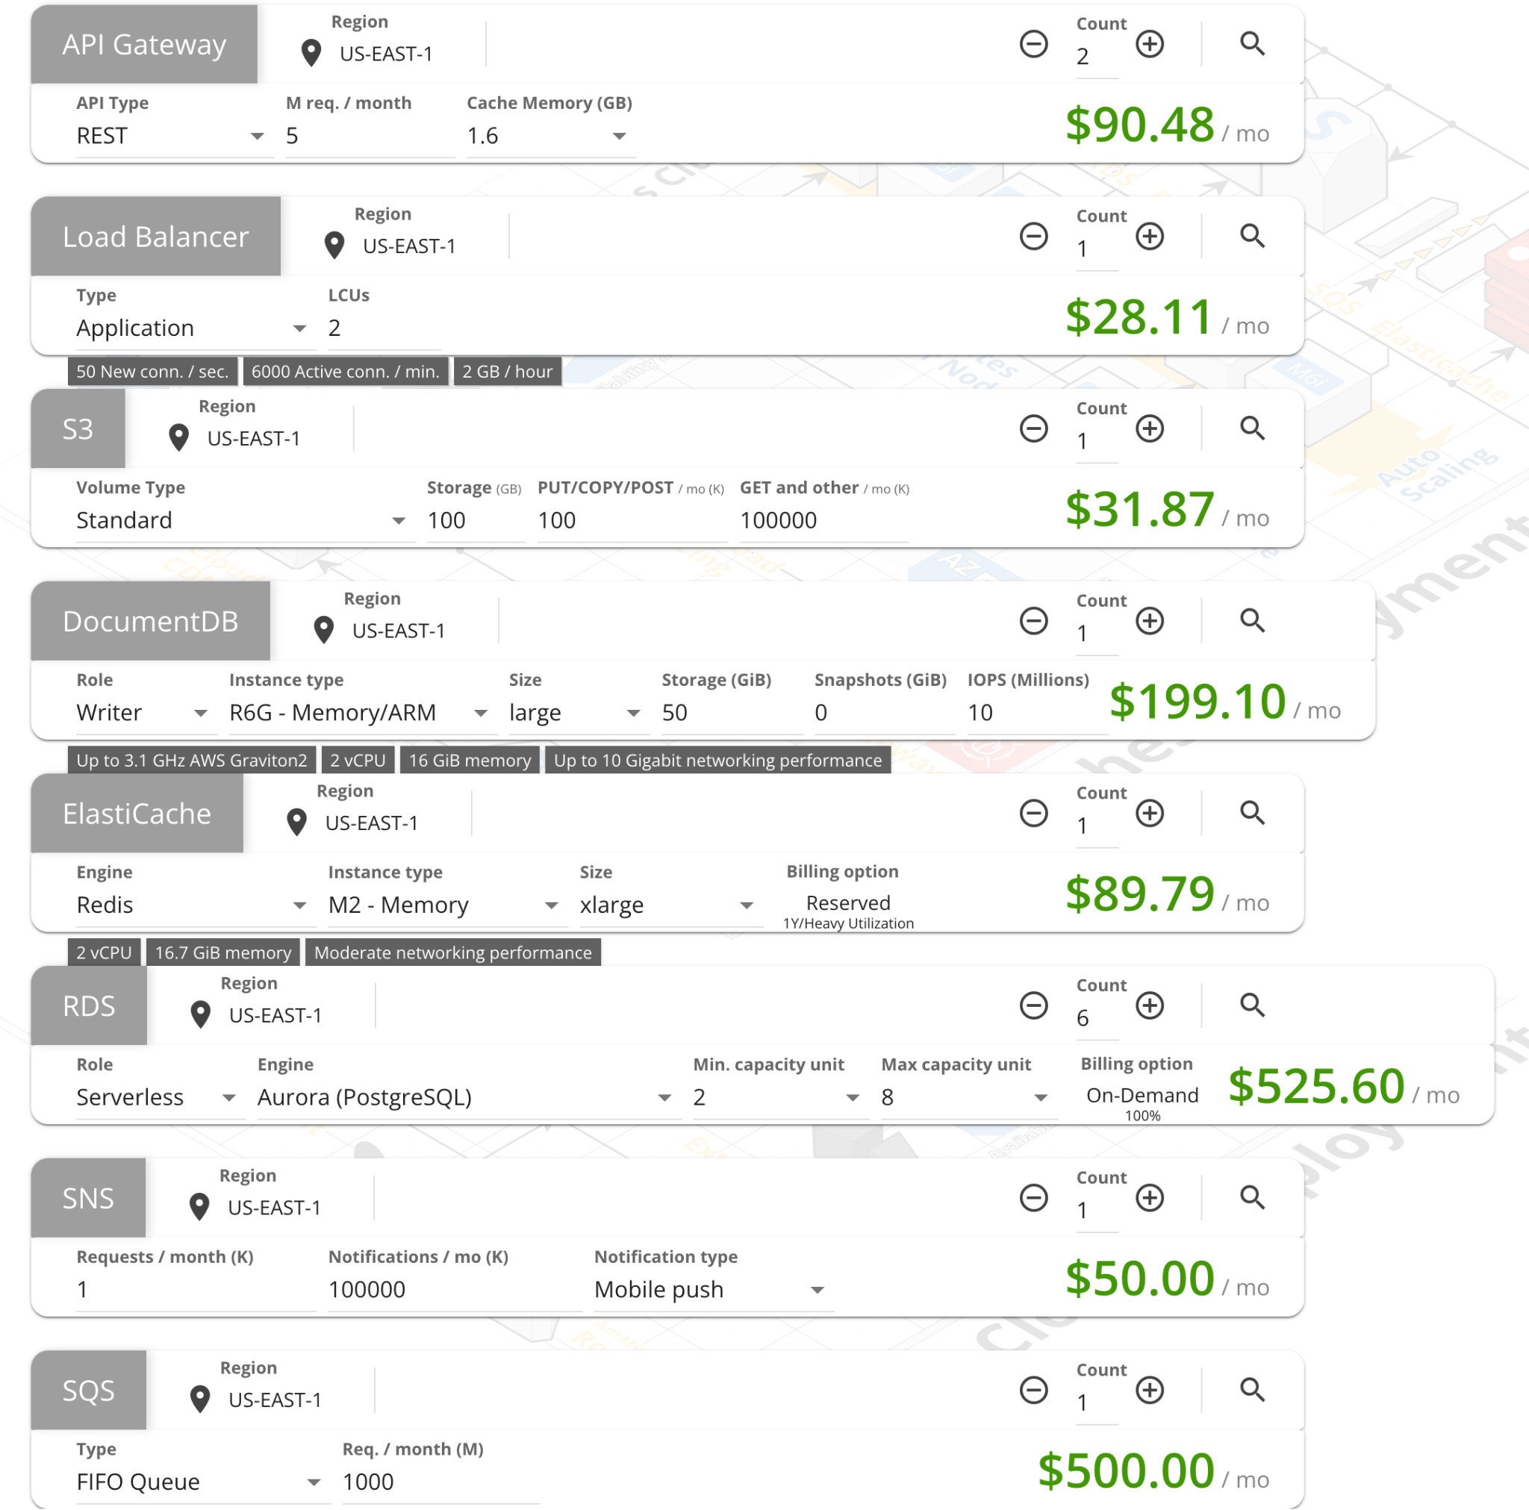
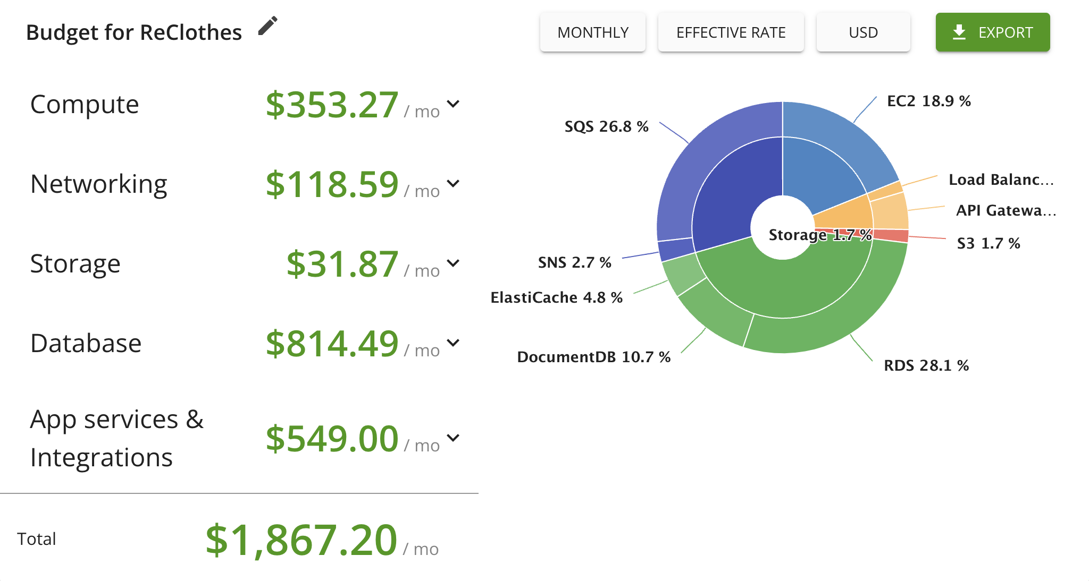
Cost Estimate
This budget plan is only for phase 1 in the production environment and does not contain development, testing, and staging environments.
Generated by CloudCraft: https://www.cloudcraft.co/
26
Notes:
This is our cost estimate, for the production environment, we should pay about 1,800 dollars per month.

Slide 27

Lessons Learned,
Future Work, and References
27

Slide 28
Lessons Learned and Future Work
Lessons Learned
Steps for designing a system from the scratch
Pay more attention to the security of the system
Some great tools for designing and managing ideas
Future Work
Find a mature and portable printer
Contact a vendor to design our drop-off box
Design AR animation
28

Slide 29
References
Insights, T. B. (2022, March 21). Recycled textile market to reach USD 10.37 billion by 2028: Rising Technological Innovation and Clothing Recycling Initiative in the textile industry to drive growth, says the brainy insights. Recycled Textile Market to Reach USD 10.37 Billion by 2028 | Rising Technological Innovation and Clothing Recycling Initiative in the Textile Industry to Drive Growth, Says The Brainy Insights. Retrieved May 8, 2022, from https://www.prnewswire.com/news-releases/recycled-textile-market-to-reach-usd-10-37-billion-by-2028--rising-technological-innovation-and-clothing-recycling-initiative-in-the-textile-industry-to-drive-growth-says-the-brainy-insights-301506867.html
Textile & Fashion Waste Statistics: Facts about clothing in landfills. Eco Friendly Habits. (2022, March 25). Retrieved May 8, 2022, from https://www.ecofriendlyhabits.com/textile-and-fashion-waste-statistics/
29

Slide 30

30
Notes:
Why AWS
number on in the market, Stable
High availability
But we are not only consider AWS
Why microservices
Scalability
Size of development team, deployment and maintainance
easy to change
CI/CD

Slide 31
Appendix

Slide 32
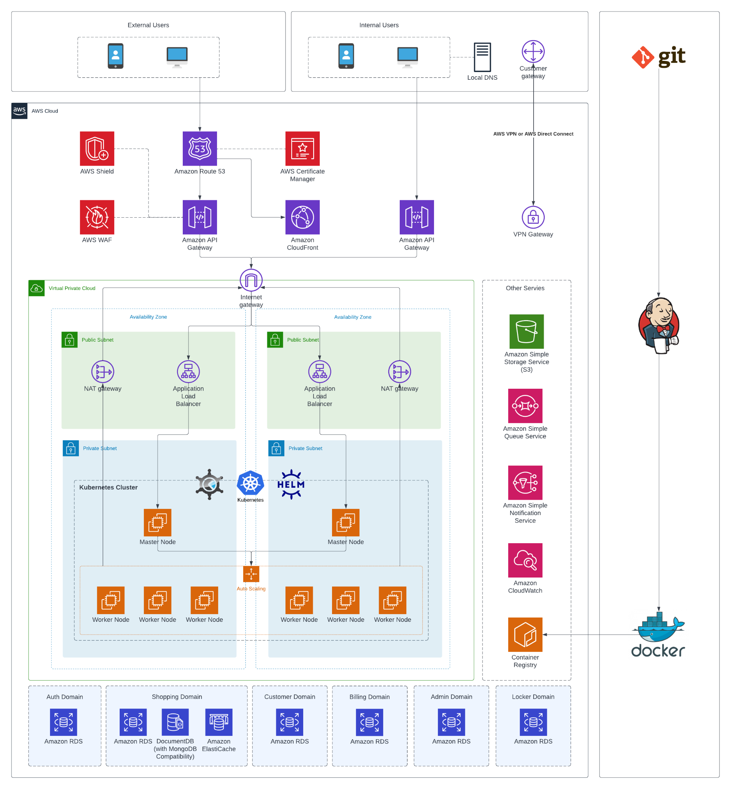
Deployment Architecture
Cloud Provider: AWS
Container Orchestration: Kubernetes
K8S Cluster Management: KOps, Helm

Slide 33
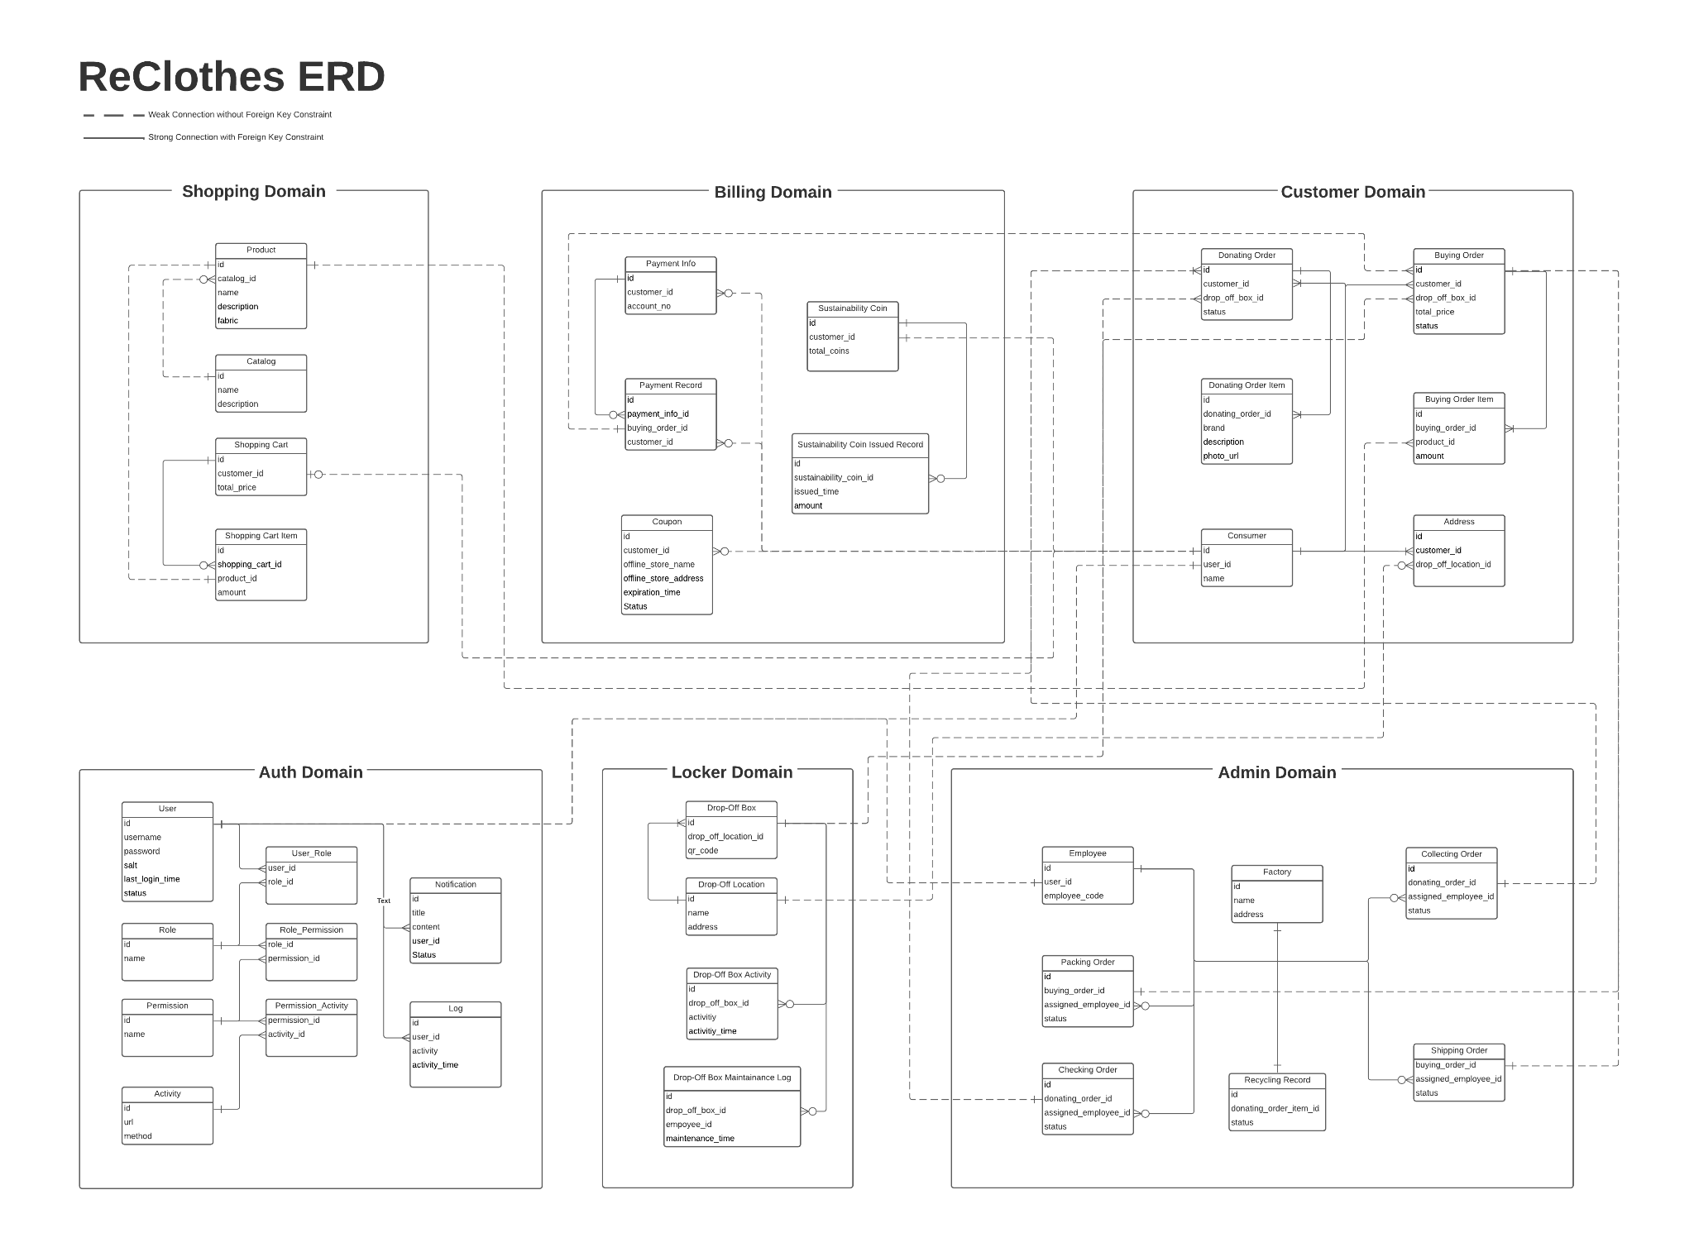

Slide 34
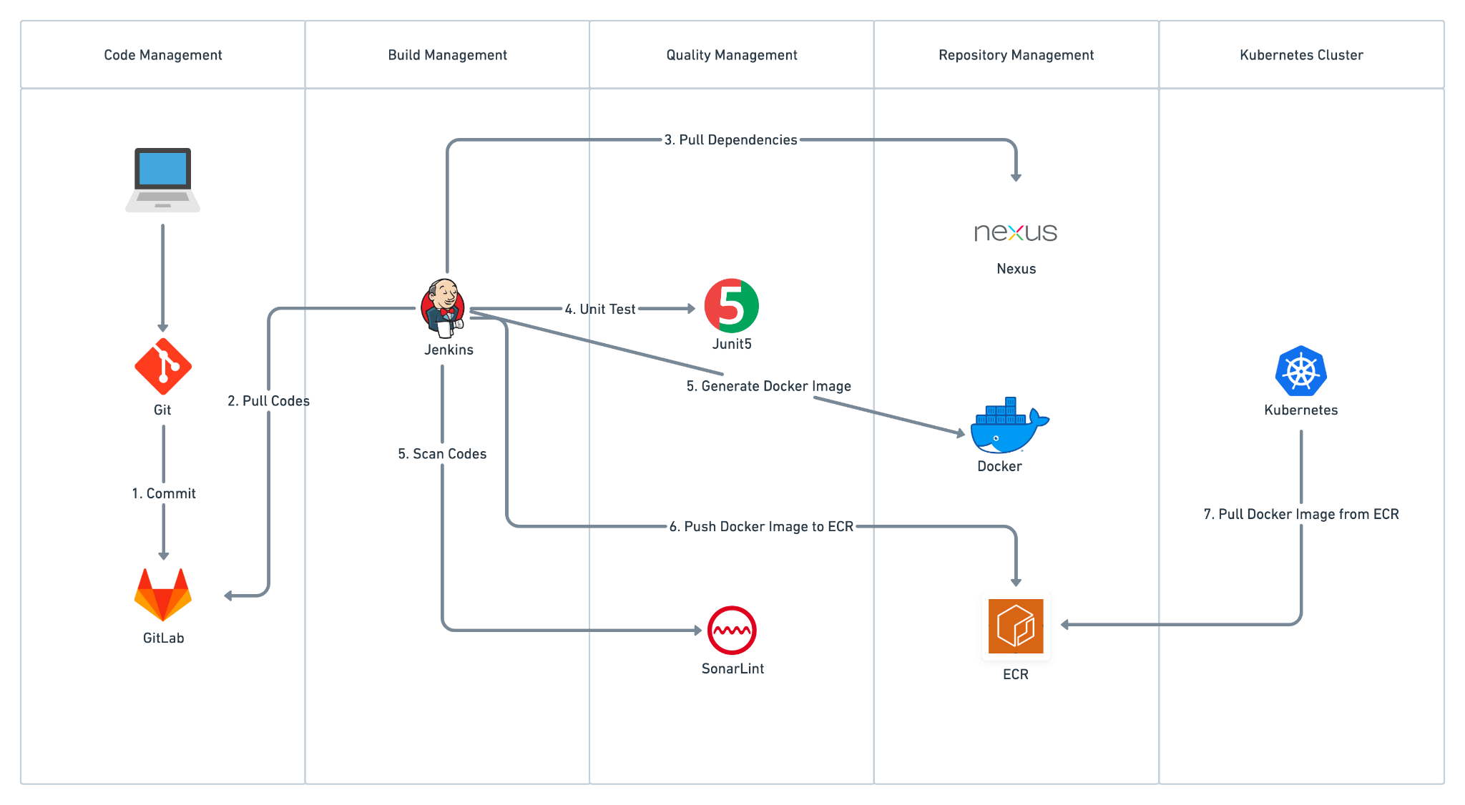
CI/CD Flow

Slide 35
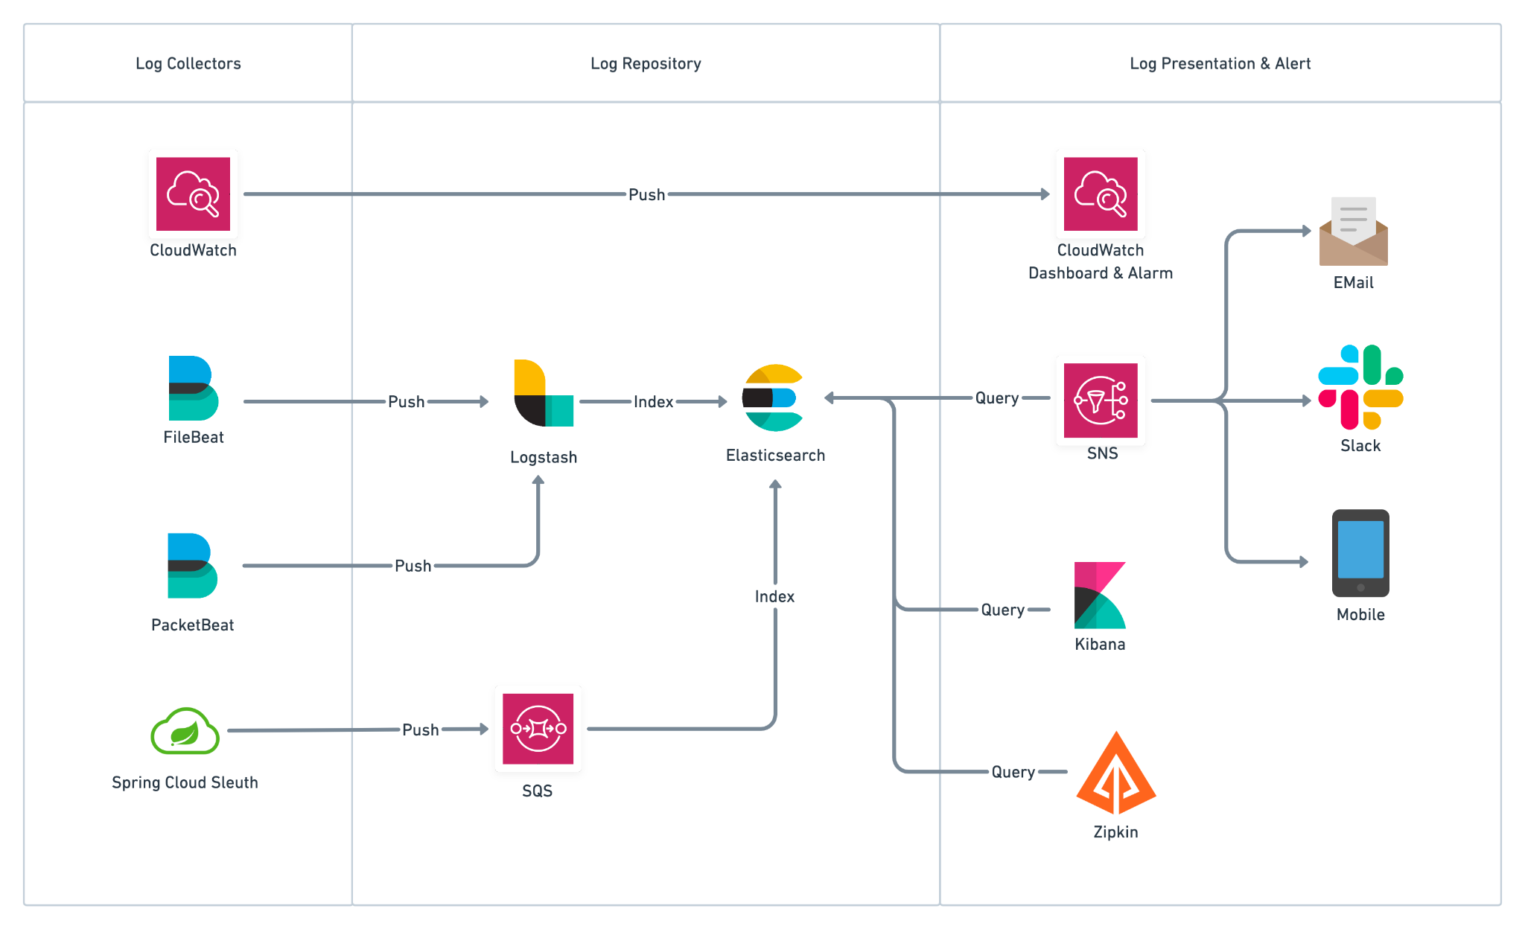
System Monitoring & Log Management

Slide 36
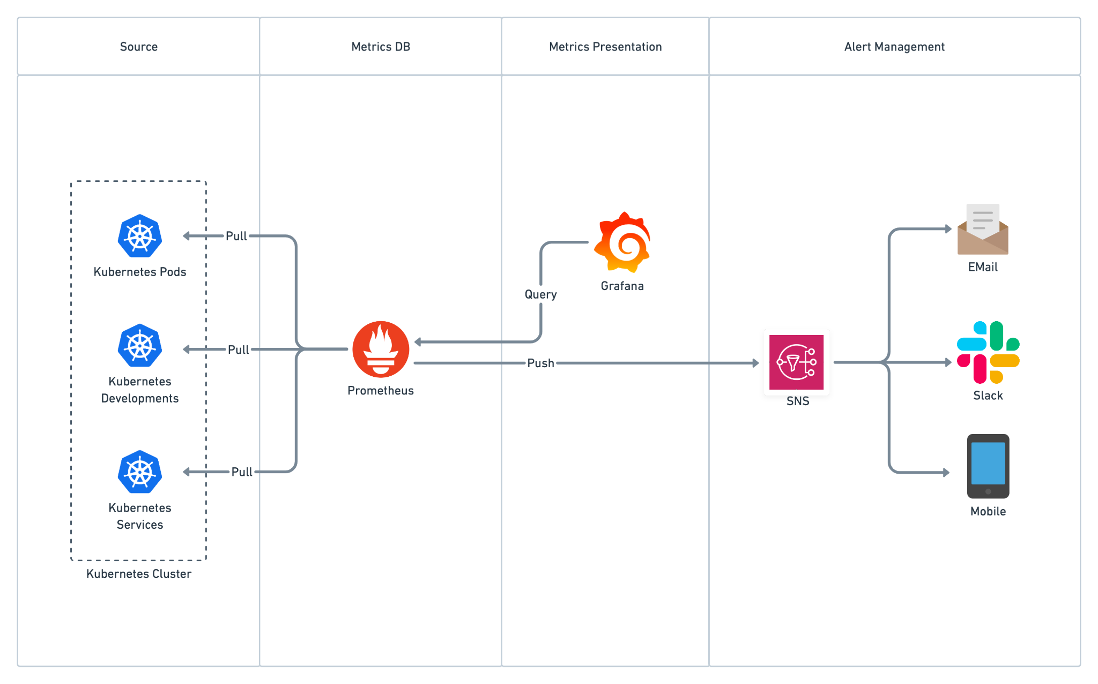
Kubernetes Cluster Monitoring

Slide 37
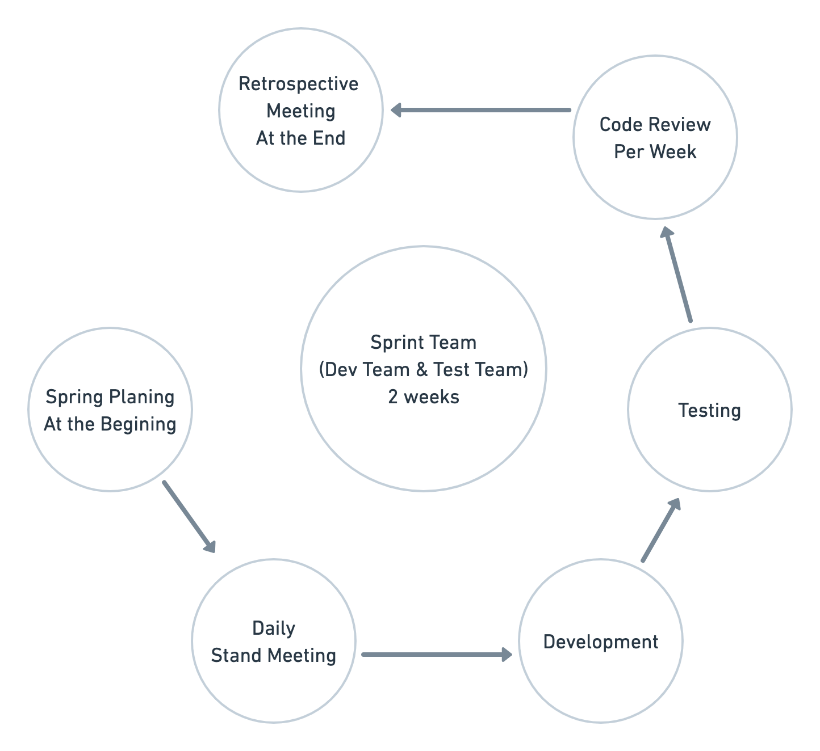
Agile Management

Slide 38
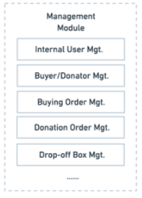
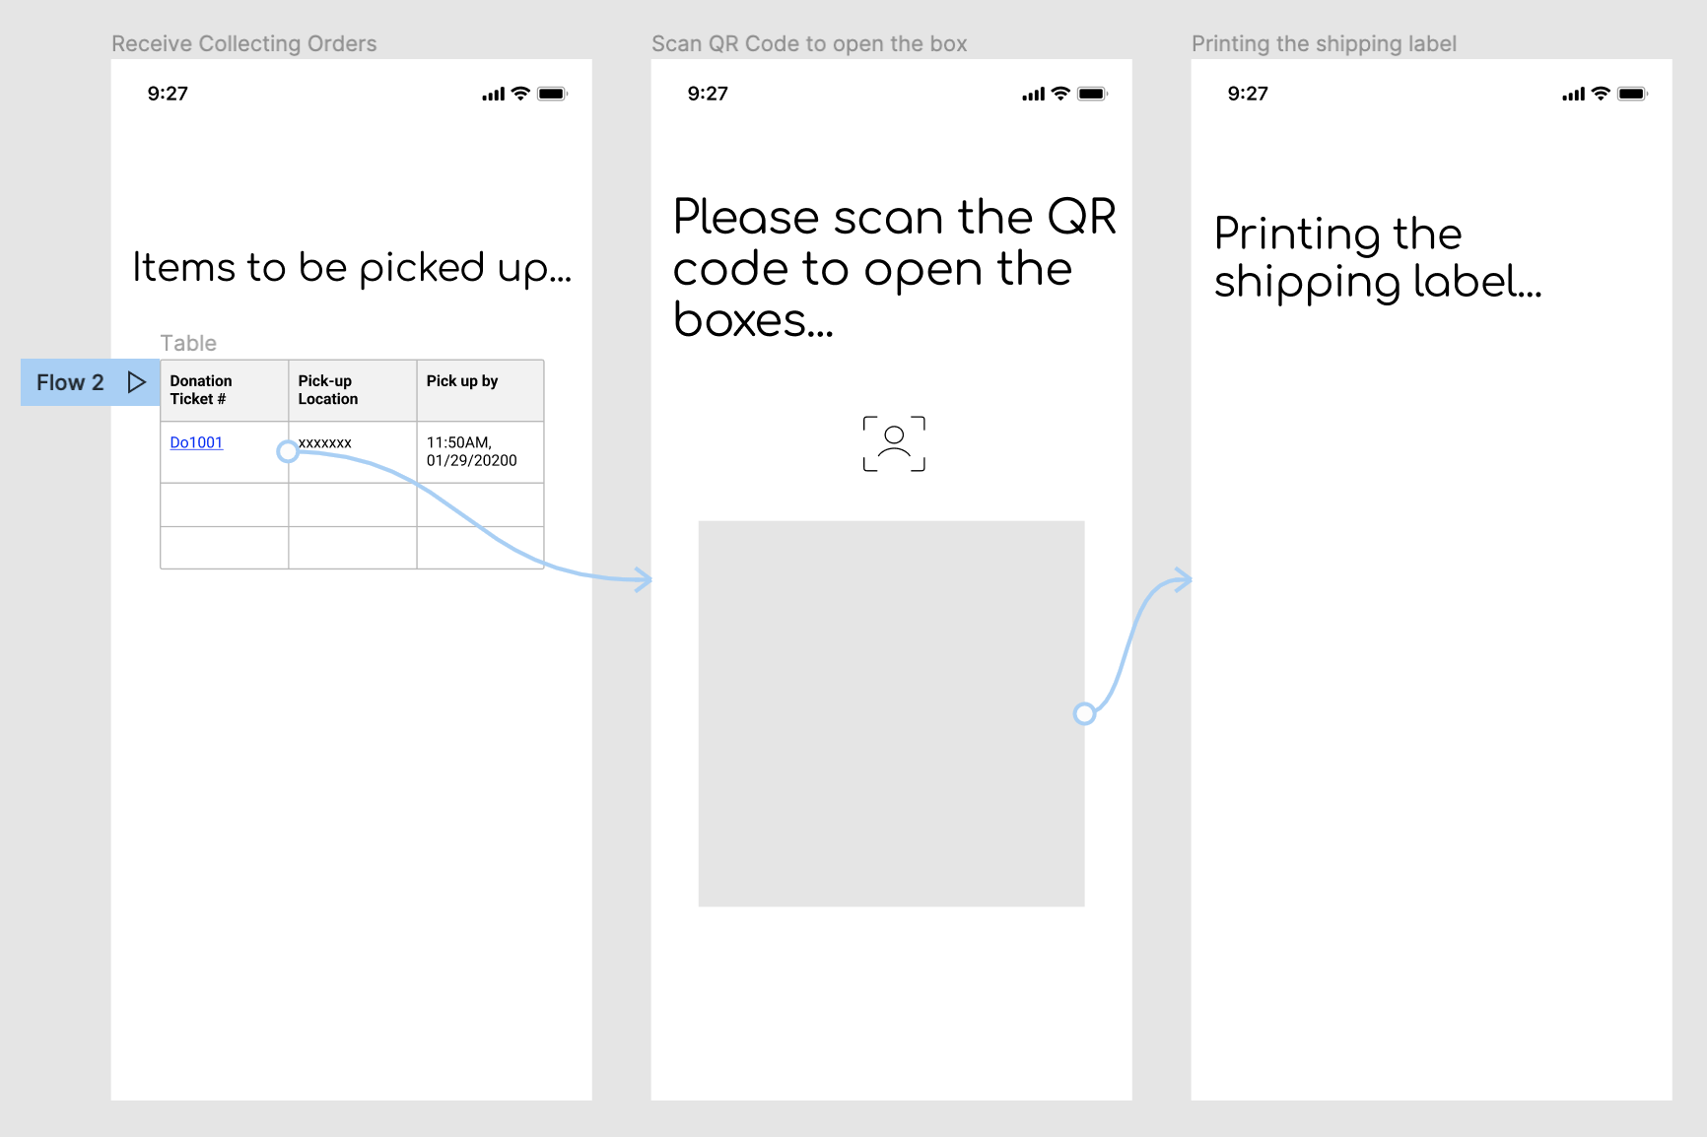
Enterprise Working Process
Delivery men’s User Interface

Slide 39
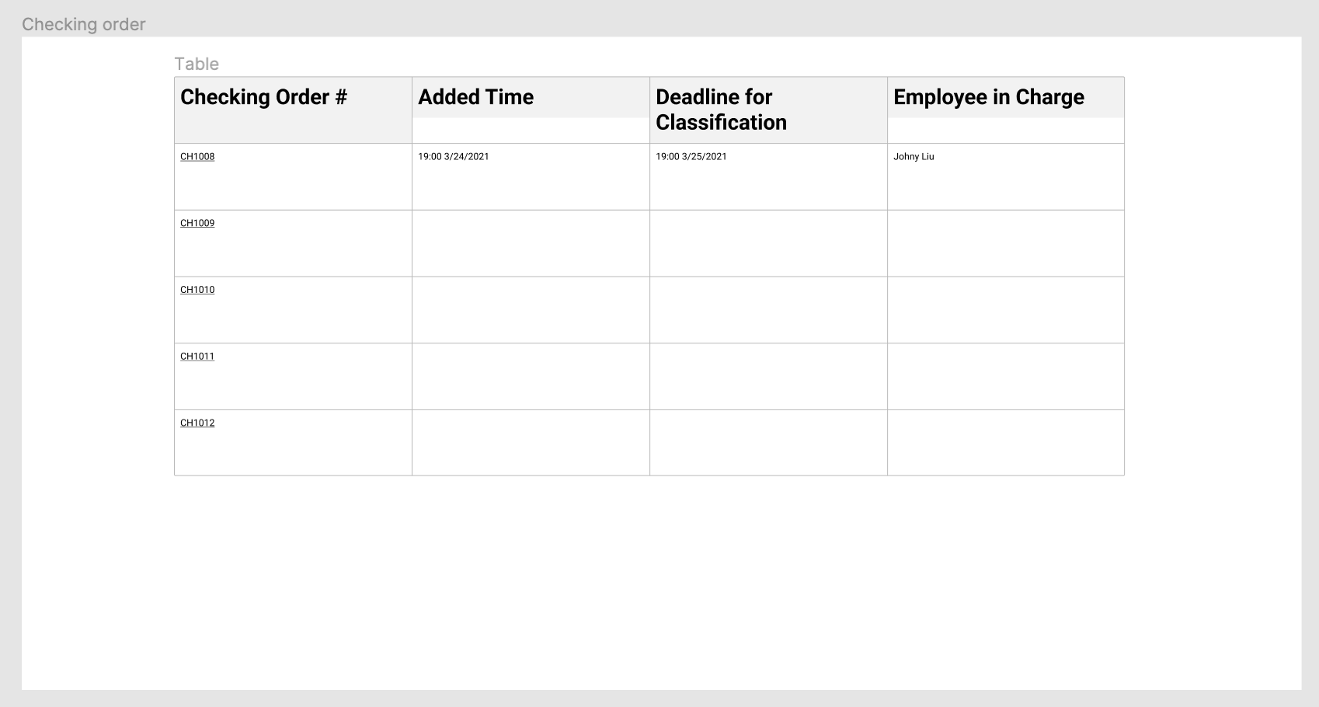
Enterprise Working Process
Reclothes Employee’s User Interface

Slide 40
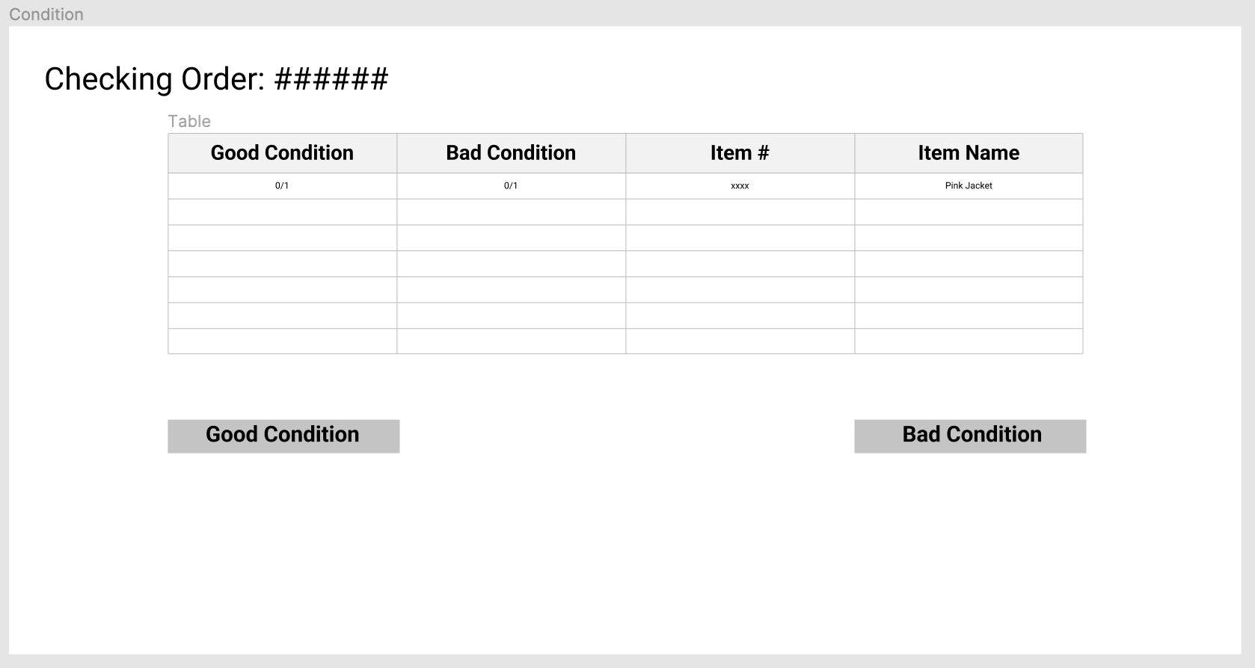
Enterprise Working Process
Reclothes Employee’s User Interface

Slide 41
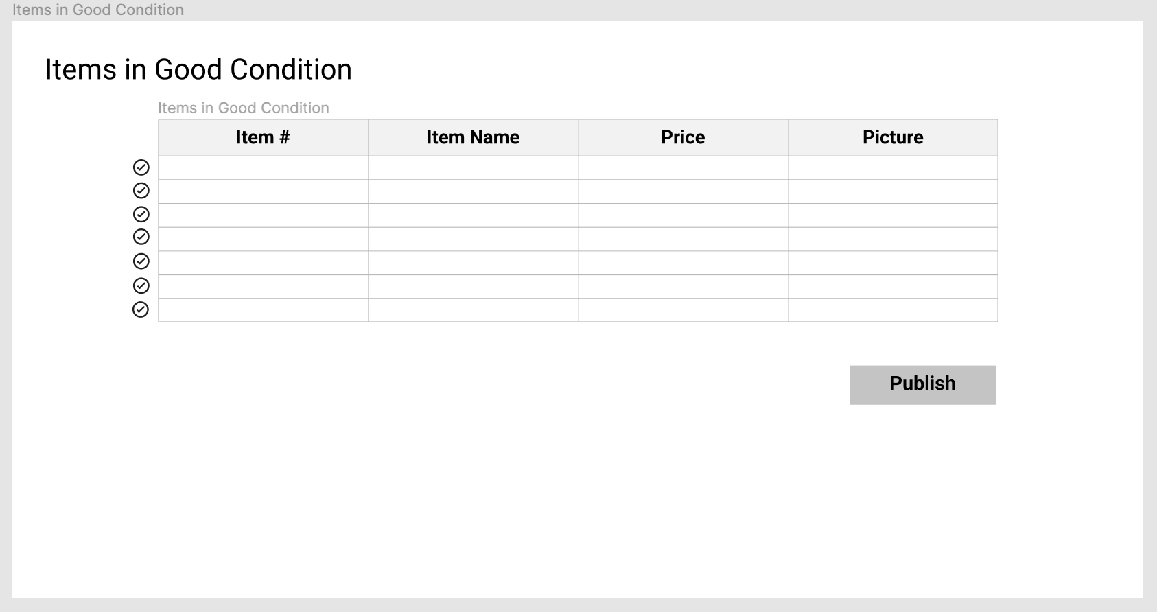
Enterprise Working Process
Reclothes Employee’s User Interface

Slide 42
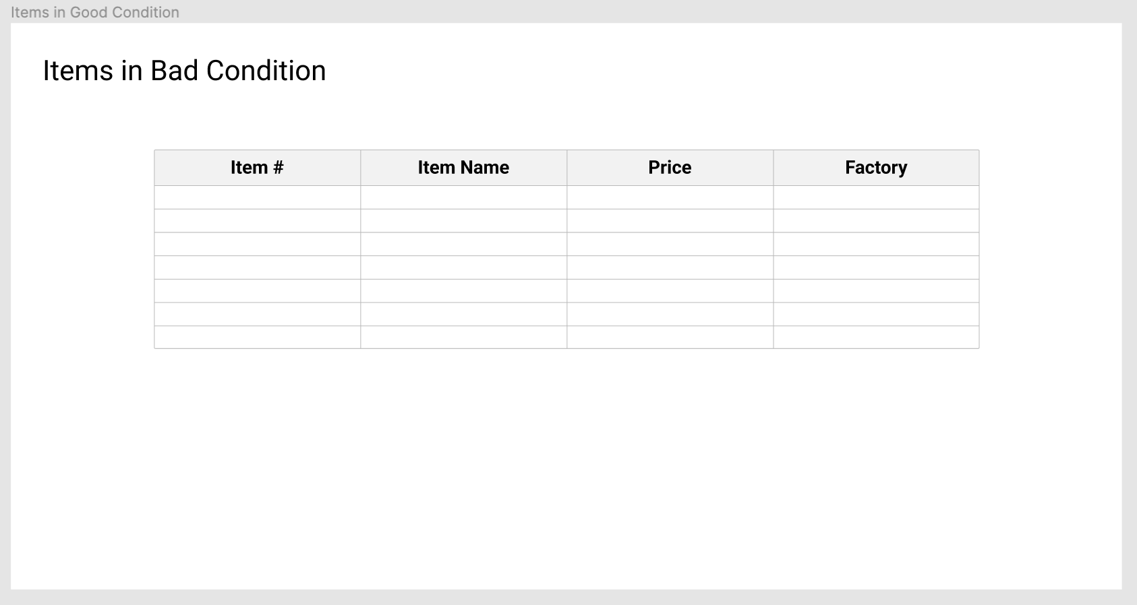
Enterprise Working Process
Reclothes Employee’s User Interface

Slide 43
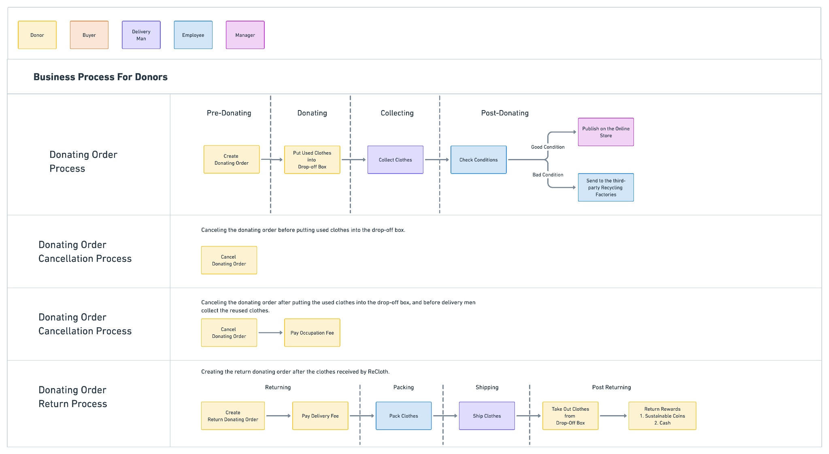
Donating Business Process
Detailed data flow:
https://whimsical.com/forward-donating-process-SU5Dtc5PkMXfbbJujxgSdE
https://whimsical.com/reverse-donating-process-EVte86wNuq3wxBDovCuT3g

Slide 44
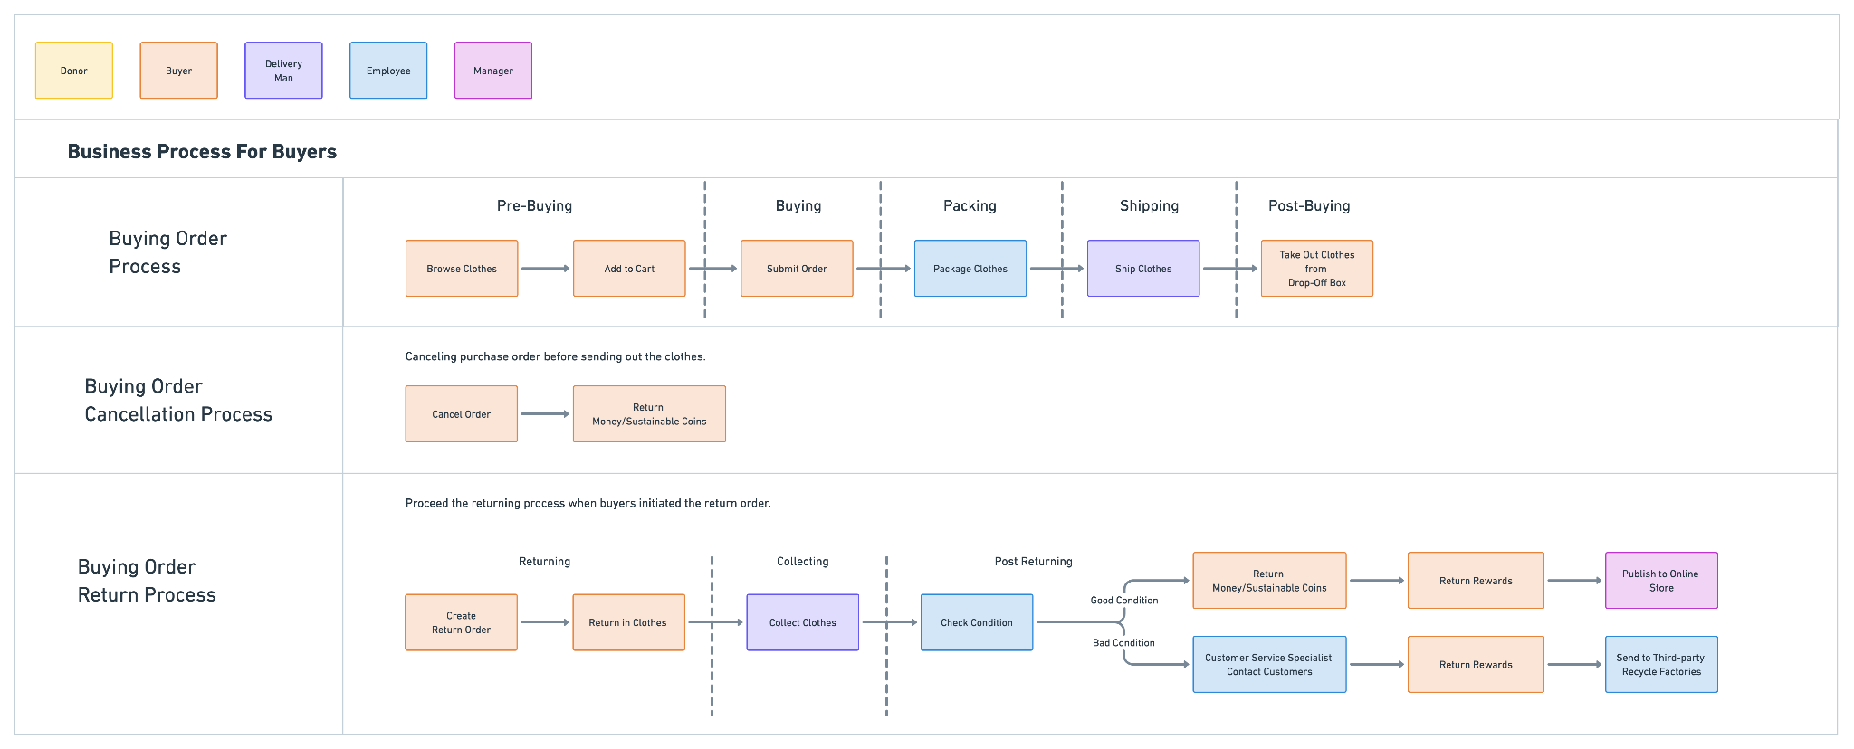
Buying Business Process
Detailed data flow:
https://whimsical.com/forward-buying-process-P8F4aQuzRK7AXVAbqQwjr6
https://whimsical.com/reverse-buying-process-QUki2uYF7AYrz9yFLQzFgQ

Slide 45
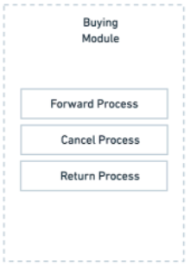
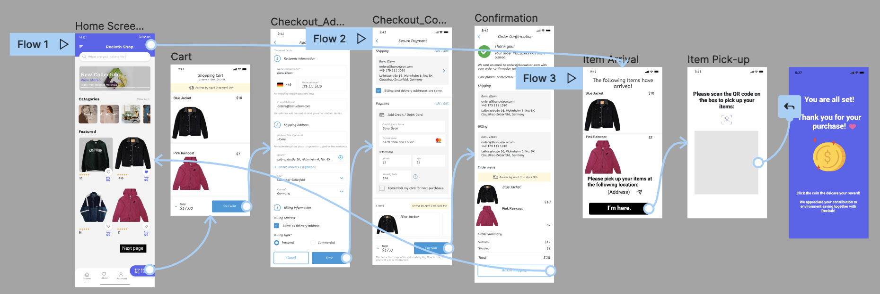
Marketplace Working Process
Buyer’s User Interface

Slide 46
Q&A

